Slide 1


Compiler Construction
Lecture 01

Slide 2
Objectives
You will learn about;
Unit 1.1 :
  Language Processors
Unit 1.2 :
  Types of Compiler
Unit 1.3 :
  The Structure of a Compiler
  Phases of Compiler
Unit 1.4 :
  Role of Runtime System
Unit 1.5 :
  Science of Building a Compiler

Slide 3
Chapter 01
Introduction

Slide 4
UNIT 1.1
Home
  Language Processors

Slide 5
Compilers
Programming languages are notations for describing computation to people and to machines.
All the software running on the computers was written in some programming language.
Types of Languages:
  High level languages
  Low level languages
  Machine level languages
Content adopted from Compilers Principles, Techniques and Tools by Alfred V. Aho, Ravi Sethi and Jeffry D. Ulman

Slide 6
Compilers
A program must be translated into a form in which it can be executed by a computer.
  The software systems that do this translation are called COMPILERS
Program in Source Language
Program in Target Language
Compiler
Errors

Slide 7
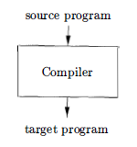
Languages Preprocessors
Simply stated, a compiler is a program that can read a program in one language -
the source language - and translate it into an equivalent program in another
language - the target language;
Important Role
  Report errors, if any, found in source program.

Slide 8
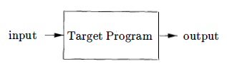
Languages Preprocessors
If the target program is an executable machine-language program, it can
then be called by the user to process inputs and produce outputs;

Slide 9
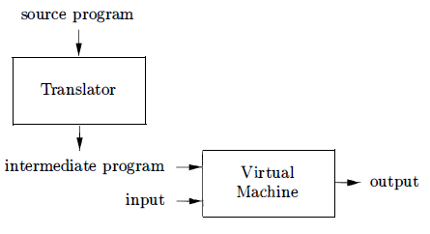
Languages Preprocessors
Ex.
Java language processors combine compilation and interpretation shown as follows:
A Hybrid Compiler

Slide 10
Languages Preprocessors
A Java source program may first be compiled into an intermediate form called bytecodes
The bytecodes are then interpreted by a virtual machine
A benefit of this arrangement is that bytecodes compiled on one machine can be interpreted on another machine, perhaps across a network.

Slide 11
Languages Preprocessors
In order to achieve faster processing of inputs to outputs, some Java compilers use just-in-time compilers
  It translates the bytecodes into machine language immediately before they run the intermediate program to process the input.
In addition to a compiler, several other programs may be required to create an executable target program.

Slide 12
Languages Preprocessors
A source program may be divided into modules stored in separate files.
The task of collecting the source program is sometimes entrusted to a separate program, called a preprocessor
The modified source program is then fed to a compiler.
The compiler may produce an assembly-language program as its output, because assembly language is easier to produce as output and is easier to debug.
The assembly language is then processed by a program called an assembler that produces relocatable machine code as its output.

Slide 13
Languages Preprocessors
Large programs are often compiled in pieces, so the relocatable machine code may have to be linked together with other relocatable object files and library files into the code that actually runs on the machine.
The linker resolves external memory addresses, where the code in one file may refer to a location in another file.
The loader then puts together all of the executable object files into memory for execution.

Slide 14
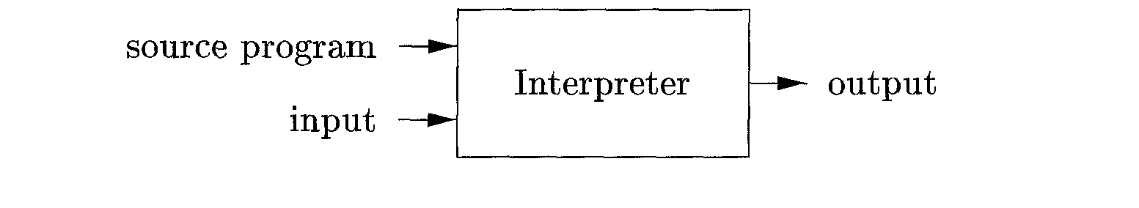
Languages Preprocessors
An interpreter is another common kind of language processor. Instead of producing a target program as a translation, an interpreter appears to directly execute the operations specified in the source program on inputs supplied by the user.
The machine-language target program produced by a compiler is usually much faster than an interpreter at mapping inputs to outputs .
An interpreter, however, can usually give better error diagnostics than a compiler, because it executes the source program statement by statement.

Slide 15
Language Processing System
Source Program
Interpreter
Modified Source Program
Compiler
Target Assembly Program
Assembler
Relocatable Machine Code
Library File
Relocatable Object Files
Target Machine Code
Linker / Loader

Slide 16
Languages Preprocessors
An interpreter is another common kind of language processor. Instead of producing a target program as a translation, an interpreter appears to directly execute the operations specified in the source program on inputs supplied by the user.
The machine-language target program produced by a compiler is usually much faster than an interpreter at mapping inputs to outputs .
An interpreter, however, can usually give better error diagnostics than a compiler, because it executes the source program statement by statement.

Slide 17
UNIT 1.2
Home
  Types of Compilers

Slide 18
Types of Compilers
Compiler can be divided into following four main types.
1. One pass compilers
2. Multi pass compilers
3. Optimizing compilers (Three Pass Compilers)
4. Load and go compilers

Slide 19
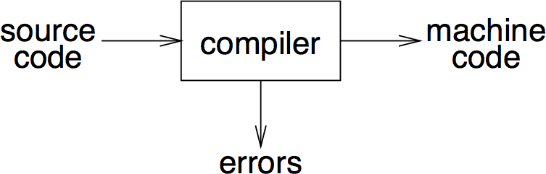
One Pass Compiler

Slide 20
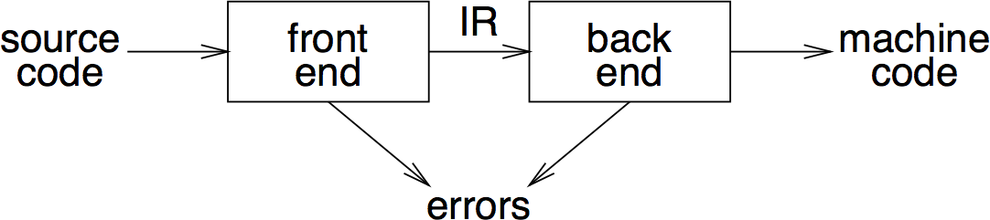
Two Pass Compiler

Slide 21
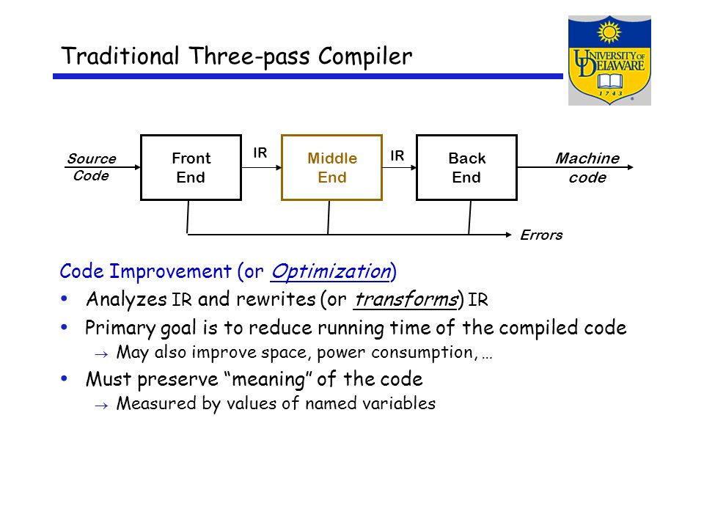
Three Pass Compiler

Slide 22
Load & Go Compiler
A load and go compiler generates machine code and then immediately executes it.
Compilers usually produce either absolute code that is executed immediately upon conclusion of the compilation or object code that is transformed by a linking loader into absolute code.
These compiler organizations will be called Load & Go and Link/Load.
Both Load & Go and Link/Load compilers use a number of passes to translate the source program into absolute code.
A pass reads some form of the source program, transforms it into an another form, and normally outputs this form to an intermediate file which may be the input of a later pass.

Slide 23
UNIT 1.3
Home
  The Structure of a Compiler and
  Phases of Compiler

Slide 24
Structure of Compiler
If we open the Compiler Box a little, There are two parts to this mapping.
Analysis determines the operations implied by the source program which are recorded in a tree structure.
Synthesis takes the tree structure and translates the operations therein into the target program.

Slide 25
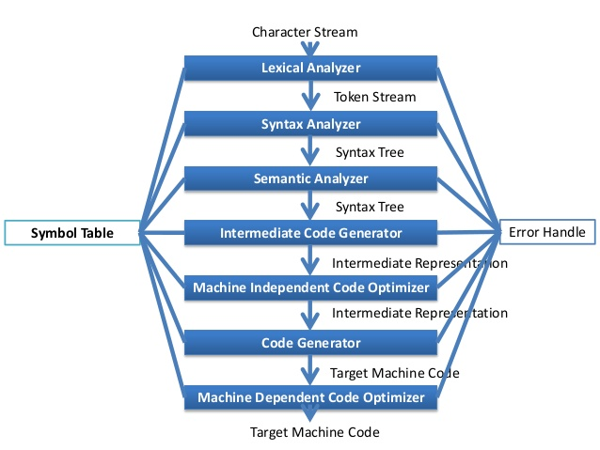
Phases of Compiler

Slide 26
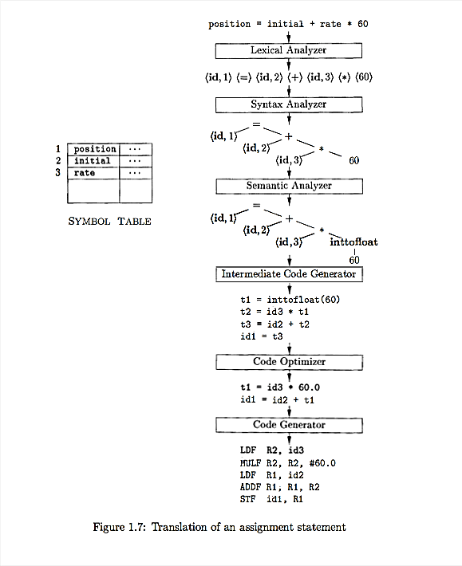
Phases of Compiler

Slide 27
Phases of Compiler

Slide 28
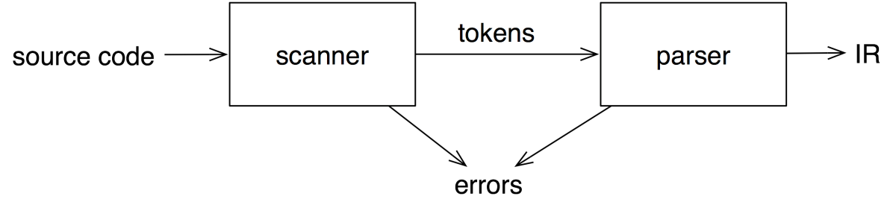
Front End
The front end recognizes legal and illegal programs presented to it and it attempts to report errors in a useful way.
Intermediate representation (IR)
Maps legal code into IR
Allows multiple front ends
multiple passes ⇒ better code
preliminary storage map
shape code for the back end

Slide 29
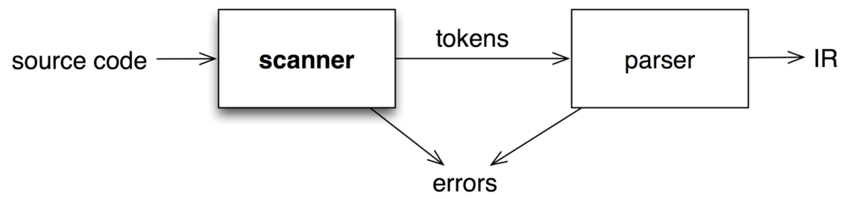
Front End (Scanner)
The scanner takes a program as input and maps the character stream into “words” that are the basic unit of syntax.

Slide 30
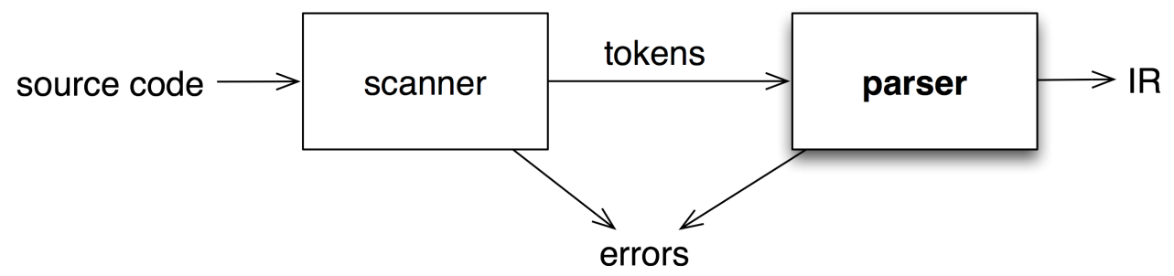
Front End (Parser)
The parser takes in the stream of tokens, recognizes context- free syntax and reports errors.
It guides context-sensitive (“semantic”) analysis for tasks like type checking.
The parser builds IR for source program.
The syntax of most programming languages is specified using Context-Free Grammars (CFG).
Parser generators mechanize much of the work

Slide 31
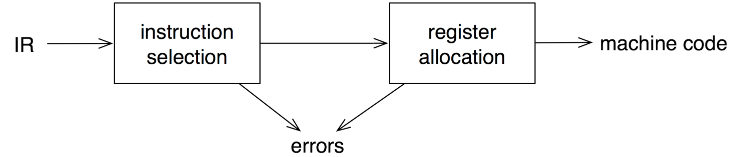
Backend
Translate IR into target machine code
Choose instructions for each IR operation
Decide what to keep in registers at each point
Ensure conformance with system interfaces

Slide 32
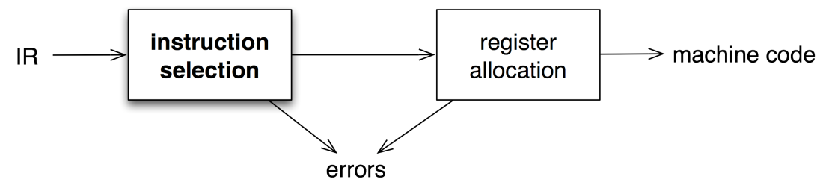
Backend (Instruction Selection)
Modern processors have multiple functional units. The back end needs to schedule instructions to avoid hardware stalls and interlocks.
Produce compact, fast code
Use available addressing modes
Pattern matching problem
  ad hoc techniques
  tree pattern matching
  string pattern matching
  dynamic programming

Slide 33
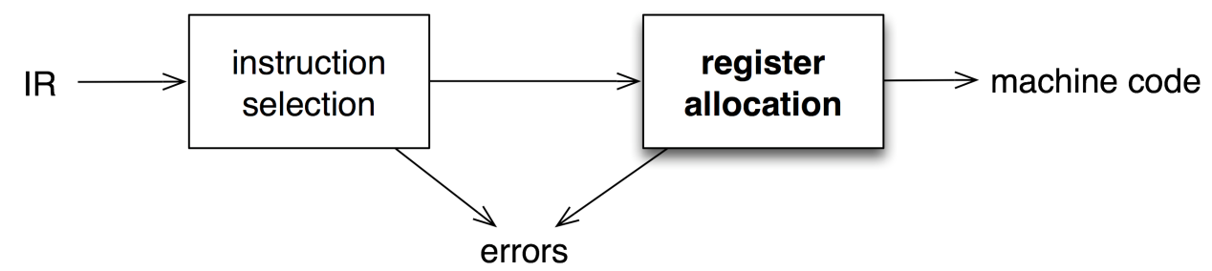
Backend (Register Selection)
Have value in a register when used
Limited resources
Changes instruction choices
Can move loads and stores
Optimal allocation is difficult

Slide 34
UNIT 1.4
Home
  Role of Runtime System

Slide 35
Role of Runtime System
The executable code typically runs as a process in an Operating System (OS) Environment.
Compilers need to have an intimate knowledge of the runtime system to make effective use of the runtime environment and machine resources.
The issues in this context are:
· Memory management
· Allocate and de-allocate memory
· Garbage collection
· Run-time type checking
· Error/exception processing
· Interface to OS – I/O
· Support for parallelism
· Parallel threads
· Communication and synchronization

Slide 36
UNIT 1.5
Home
  Science of Building a Compiler

Slide 37
Science of Building a Compiler
Modeling in Compiler Design and Implementation
The Science of Code Optimization
Optimization for Computer Architecture
- Parallelism
- Memory Hierarchies
- RISC
- Specialized Architecture
VLIW (Very Long Instruction Word)
SIMD (Single Instruction Multiple Data)
MIMD (Multiple Instruction Multiple Data)

Slide 38
Exercises
Exercise 1: Indicate which of the following terms:
a) imperative b) declarative c) von Neumann d) object-oriented e) functional f) third-generation
g) fourth-generation h) scripting
Exercise 2: Explain the terms:
Compiler
Machine and Assembly Languages.
Compilers and Computer Architecture.
Software Productivity and Software Security.

Slide 39
Thank you

Slide 40
Content Adopted From
Compilers Principles, Techniques and Tools by Alfred V. Aho, Ravi Sethi and Jeffry D. Ulman
Web URL:
https://technology.blurtit.com/605067/what-is-load-and-go-compilers
https://affairscloud.com/compiler-design-questions-set-3/

